Slide 1
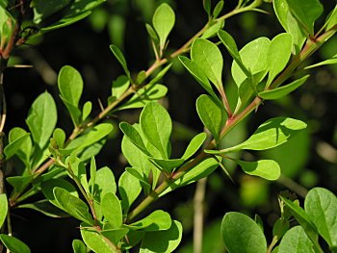
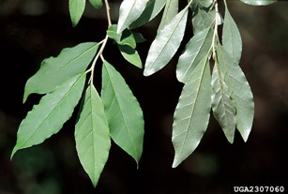
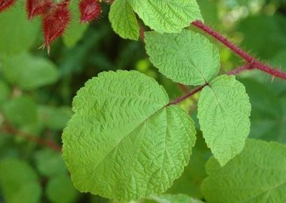
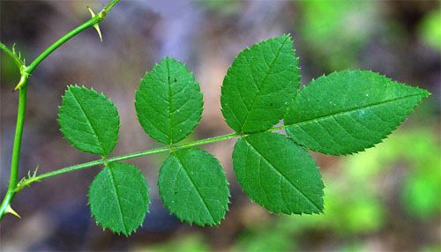
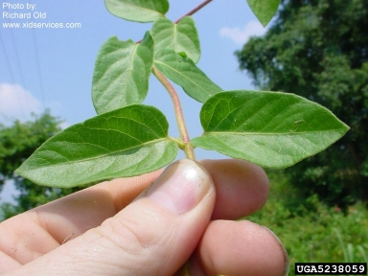
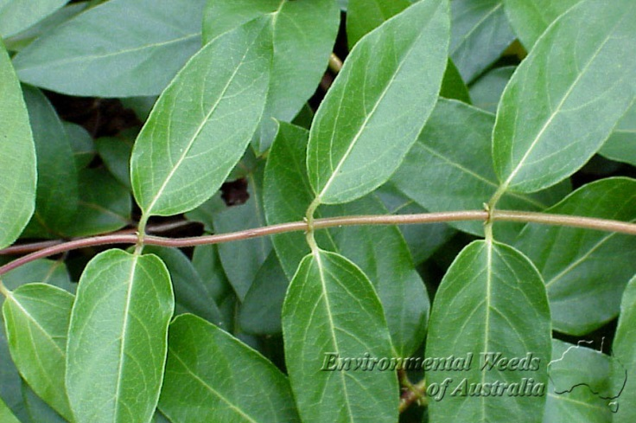
SCBI_ForesGEO - WOODY PLANTS-Highly Invasive
BETH: Japanese Barberry
ELUM: Autum Olive
Dense, spiny shrub
Small tree
Round leaves
Needle at base!
Leaves silvery beneath
RUPH: Wine berry
ROMU: Multiflora rose
Both slender shrubs
Red stem
Annoying prickles
LOJA: Japanese honeysuckle
Woody vine
3-5 cm between leaves
Opposite leaves

Slide 2
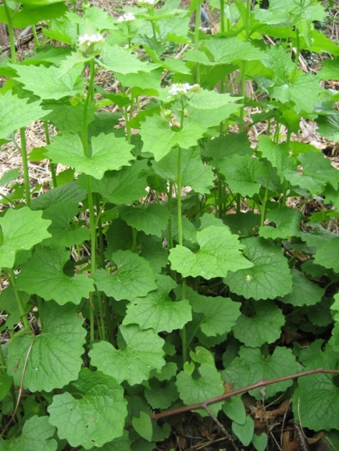
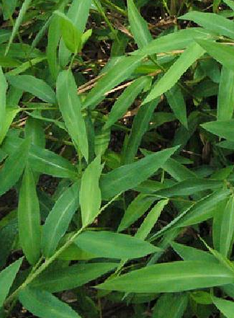
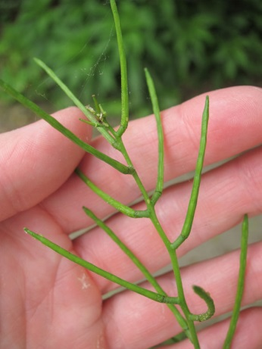
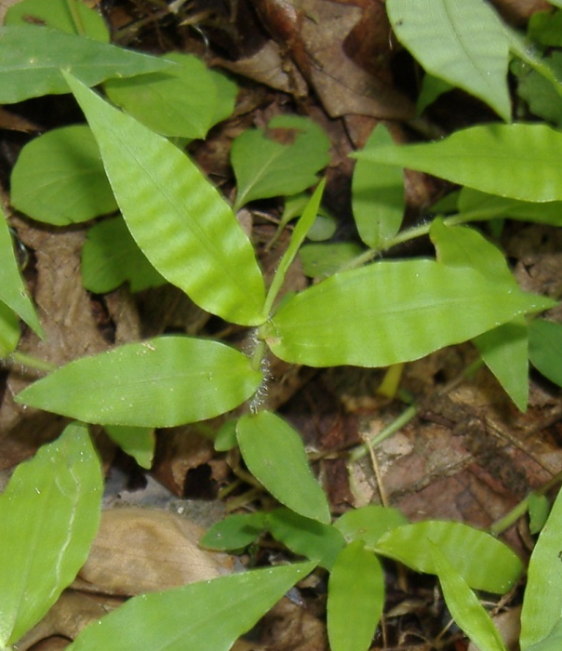
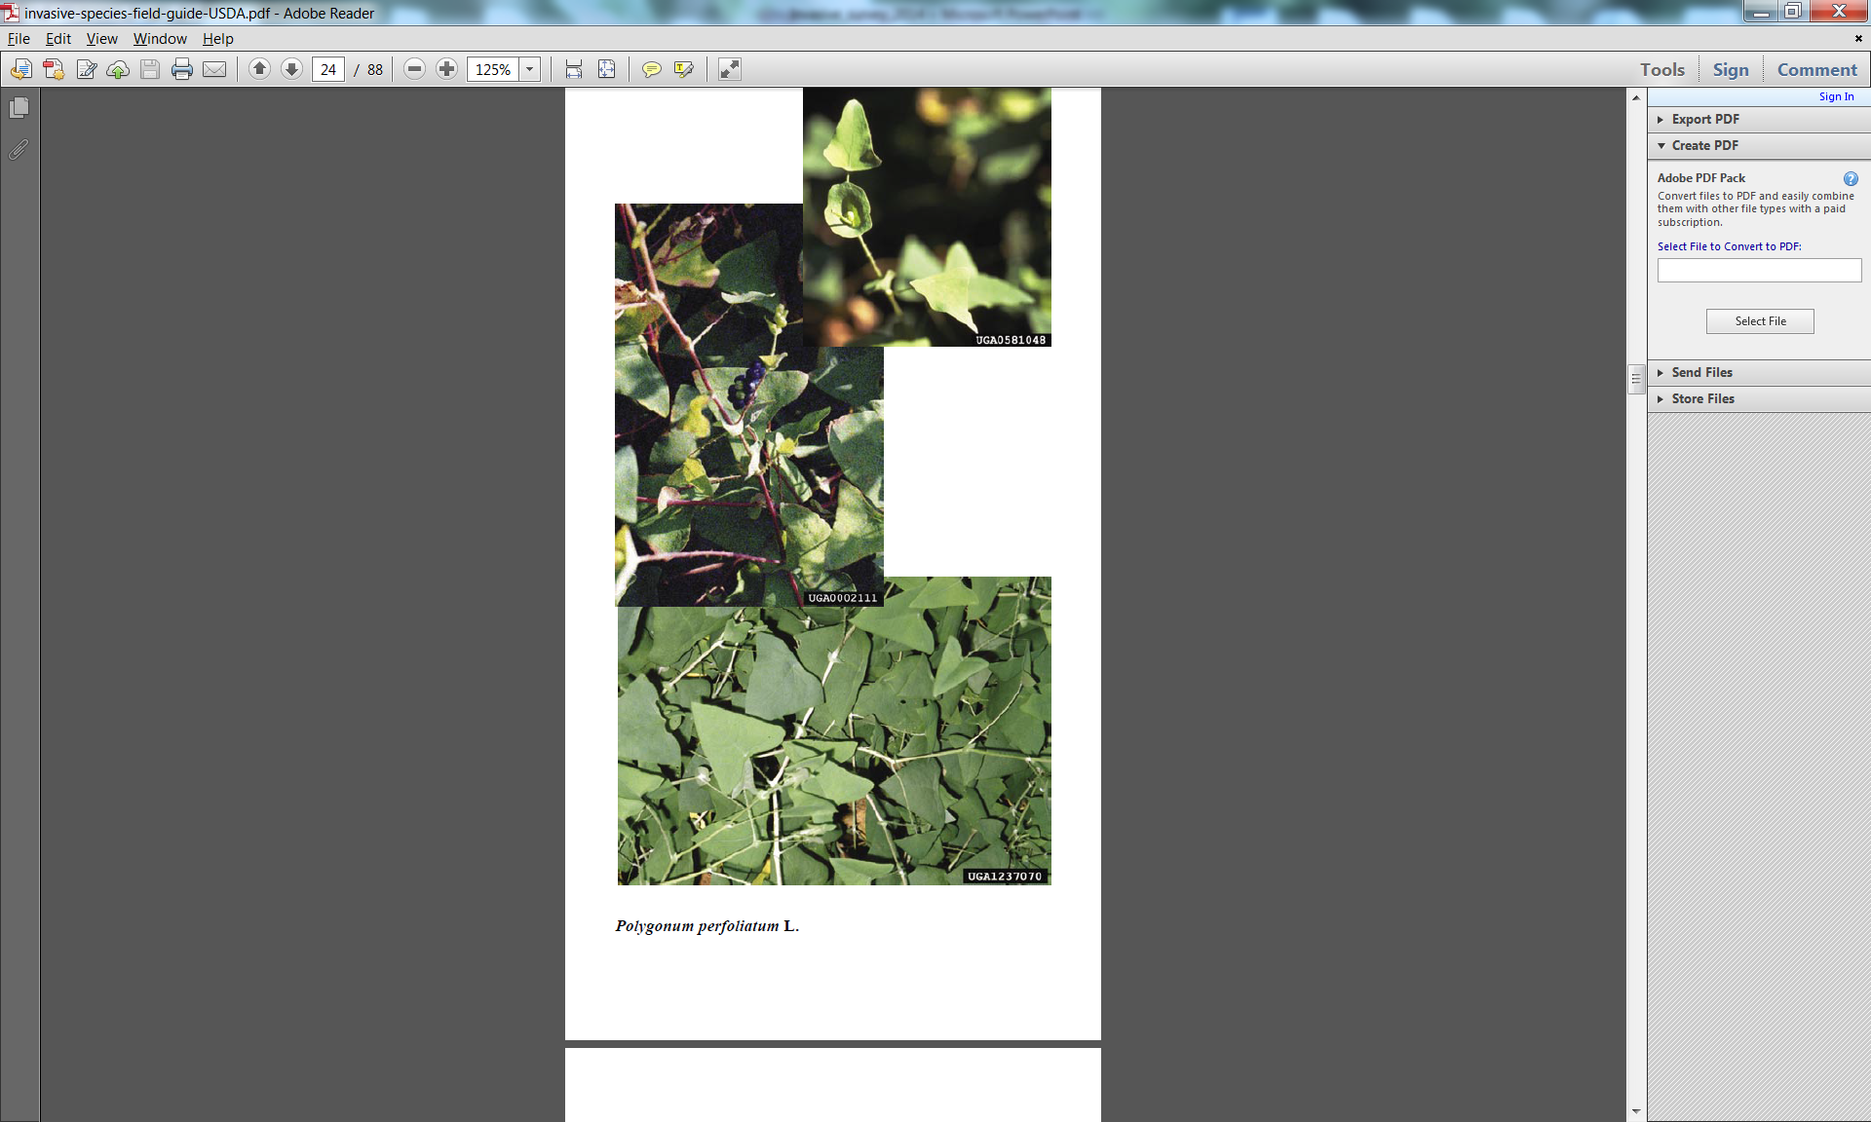
SCBI_ForesGEO - HERBACEOUS PLANTS-Highly Invasive
ALPE: Garlic mustard
MIVI: Japanese stilt grass
Rounded leaves
Elongated leaves, no ripples
Seed pods on top of plant
Everywhere!!!!
OPHI: Wavyleaf basket grass
POPE: Mile-a-minute
Ripples across leaves
Triangular leaves
Hairy stems
Annoying prickles

